Slide 1
Project: Defect Improvement Fasteners Flushness
Summitted by Beverlyn Tucker
Submitted to: Professor Darlene Ryan

Slide 2
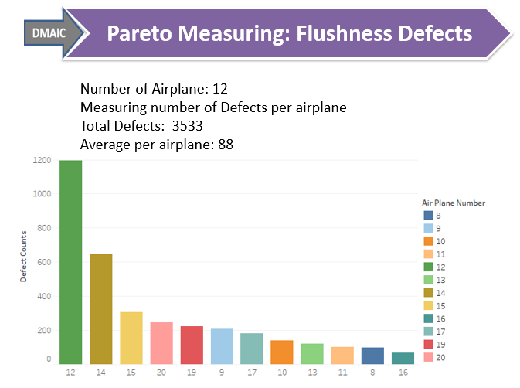
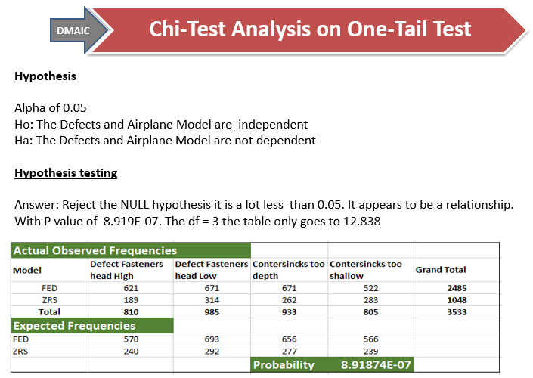
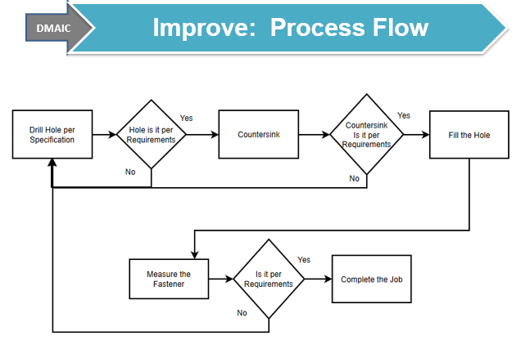
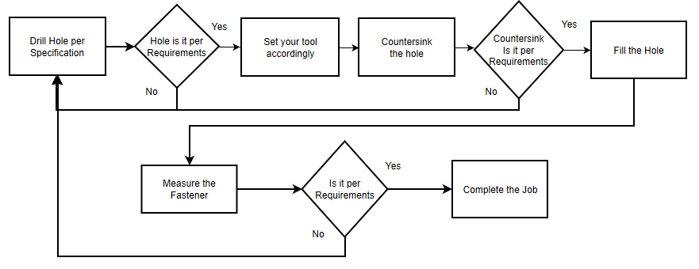
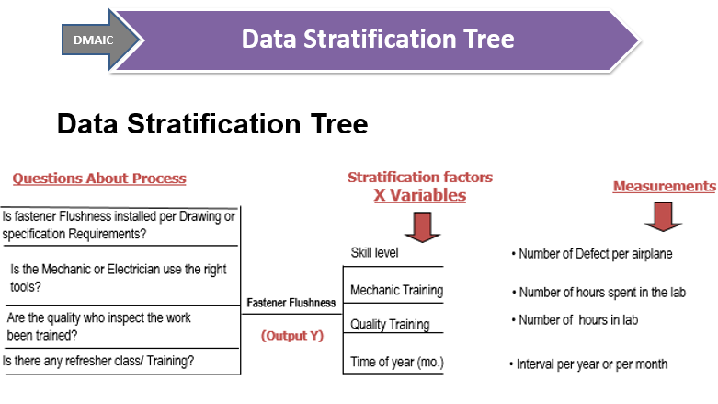
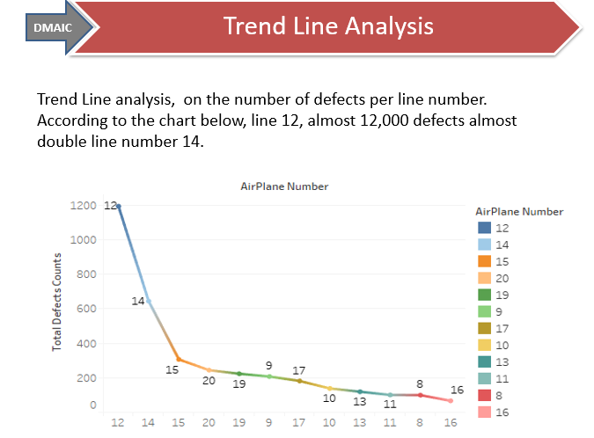
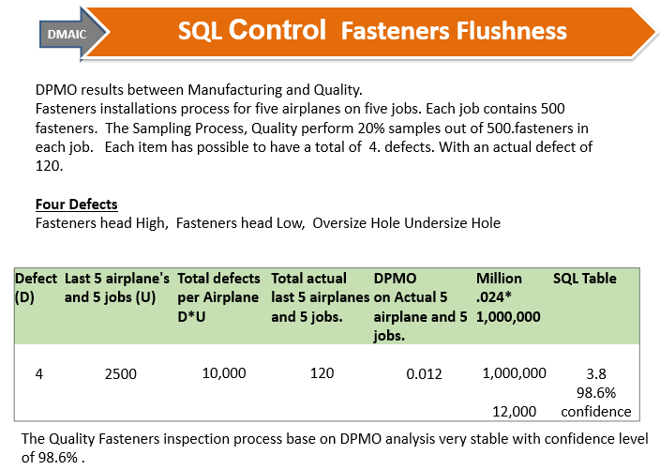
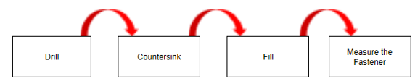

Project Title:
Defect Improvement Fasteners Flushness Process
Background: We look at the contributing factor to Fastener flashness Process
Why the defect are high.
TEAM MEMBERS
Data Analyst: Beverlyn T. Engineer: Pat C Mfg Leader: Will S
Process Owner: Natialene S Quality Leader: John H
Mfg Supervisor: Robert T Training : Lance E
May 15,2016
Team
Launch
Define
Measure
Analyze
Improve
Control
DEFINE
MEASURE
ANALYZE
IMPROVE
This process fasteners
Problem Statement:
Fastener Flushness defect items were identified in Forward Bodies in Multi Line Units, Total 3533 Defects for 12 Line Numbers. Average 271 per Unit. Total cost including overheads $223,546.
Project Scope: Forward Bodies Only, specifically to fastener flushness. All other areas processes are excluded from this project. First step is to Drill the hole and last is to measure the Flushness of the fasteners head.
Total line #: 12
Total defects: 3533
Avg defect per line#: 88
We conduct a hypotheses test Alpha of 0.05
Ho: The Defects and Airplane Model are independent
Ha: The Defects and Airplane Model are not dependent
After training & new Process. First get well airplane 64% defect reduction with total 104.
What is the cause of the high defect in airplane # 12 and # 14?
CONTROL
Current Process
Line 12 had highest Defect 2nd line 14
We found out that there were inexperience/new hire in MFG.
We conduct SQL analysis in Quality to see the condition of the process. In result Quality have a very stable process 98.6 confidence level.
Next Step is to verify MFG process
We look at the training, skills mechanics, Specification requirements and tools
Old Process; The measurement not until the end of the process. We also utilized the Thought Process refer to the Slide below
Line #12
Line #114

Slide 3
DMAIC
Define Phase
Description: Forward Bodies Defect Reduction- Fastener Flushness
Problem Statement:
Fastener Flushness defect items were identified in Forward Bodies in Multi Line Units, Total 3533 Defects for 12 Line Numbers. Average 294 per Unit. Total cost including overheads $223,546
Business impact. Late completion, cause delay to the next position unrecoverable extended overheads. The impact on both quality, cost and time.
- Expected benefits to move the airplane to the next position on time, Workflow efficiency, save money on fasteners replacement, save money and time on nonconformance initiation, disposition, and planning (Administrative work). As well as on mechanic reworked.
- Currently Cost , for 12-Line unit Grand Total Cost is $223,546
- Measure success - Time, Cost, Quality and also the strategic part. The effect of the project, Relevance to the users and the Sustainability.
Goals: 70% reduction of high Fastener Flushness issues resulting in a decrease to less than 88 defect per airplane.
D. Project Scope: Forward Bodies Only, specifically to fastener flushness. All other areas besides forward bodies and other processes are excluded from this project. First step is to Drill the hole and last is to measure the Flushness of the fasteners.

Slide 4
DMAIC
Define Phase Cont.'s
E. Team. This project composes of Manufacturing, Quality, Analysts, and Training personalities. This is also supported with our Director.
F. Project plan (very high-level). Estimate time (or date) per DMAIC step. Develop a rough timeline.
Next Stage | Discreption | Resources | Tools | Status | EDC Date
Meausre | Clearly identify the business problem / performance gap (output measure), customer, scope, goals and resources. | Analysts: To Pull Data from Teradata and data cleaning Tram collaboration: Quality, Manufacturing, Quality Engineer | Operational definitions. Kappa Process map (detailed) Data measurement plan Data stratification tree Histogram Trend/ line chart, Pareto chart Fishbone (cause/effect) diagram | Complete | 4/6/2019
Analyze | Analyze, describe, and present the data to discover the root cause(s), identify/prioritize critical inputs (x’s), determine the inputs impact on the output. | Analysts: performed analysis pertains to Fasteners flushness. Team Collaboration with Quality, Manufacturing, Quality Engineer. Training Lab if Needed | Apply Root Cause analysis Scatterplot Trend/ line chart Pareto chart | Complete | 4/15/2019
Improve | Teradata, Manual gathering, Process Witnessing as Needed. Develop Counter measure Run a Pilot | Analysts to pull the Data and canalize the data. Quality, Manufacturing, Quality Engineer. Training Lab if Needed | Affinity diagram Fishbone cause/effect diagram Pareto. Control charts. Hypothesis testing Process map. Solution selection matrix | Complete | 5/5/2019
Control | Implement process changes and controls. Verify expected performance was achieved, monitor performance to sustain new levels. | Analysts to pull and Annelize the Data. Quality, Manufacturing, Quality Engineer if needed | Control charts. Time series analysis Operational definitions. Process map Sigma Quality Level (SQL) | SQL is complete | Quarterly Interval after implementation.

Slide 5
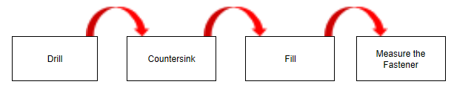
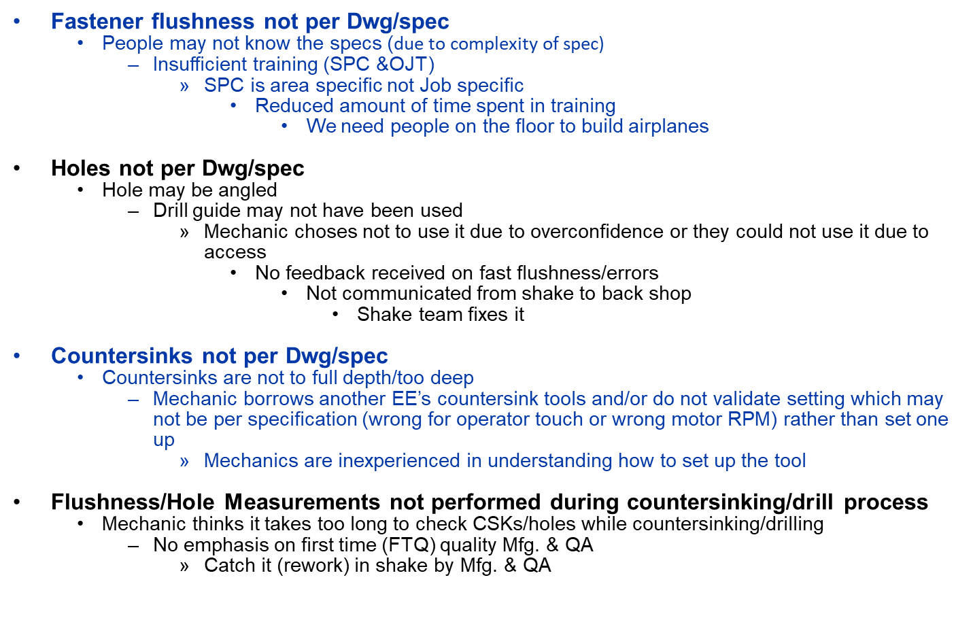
DMAIC
Define Phase Cont.'s
G. Process map
Thought Process

Slide 6
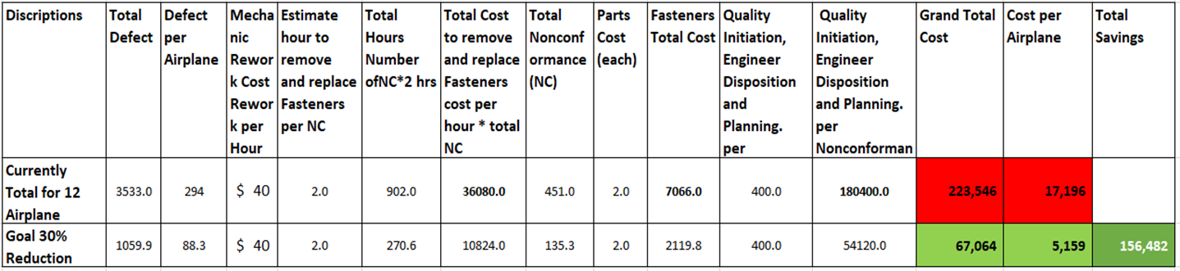
DMAIC
Defect Break Down
This project we are concentrating on the defects improvement, which points us to the discrete data. The data show’s some dollar amount, but we are going to focus the defects only. We all know that if manage our defect the cost will go down also.
We collected the data worth of one year which gives us a total of 12 airplane. Data sources Teradata. We did some data cleaning and use excel to enhance the visualizations. below is summary of the data.

Slide 7

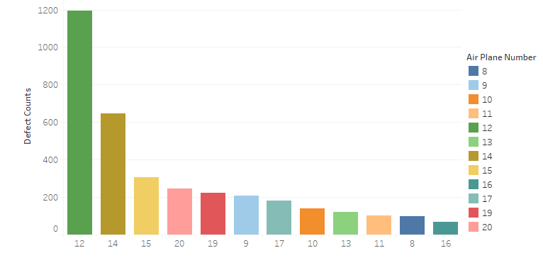
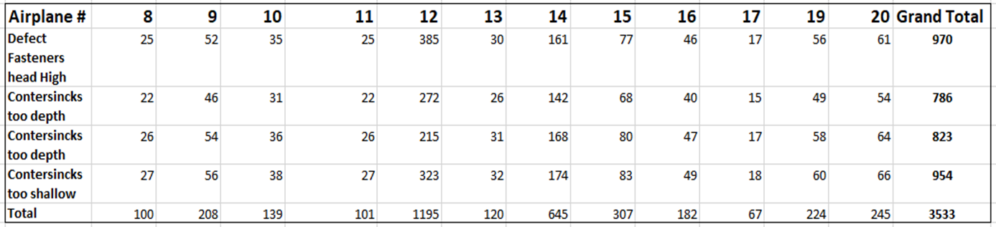
Pareto Measuring: Flushness Defects
Total Defects: 3533 Number of Airplane: 12
Average per airplane: 294

Slide 8
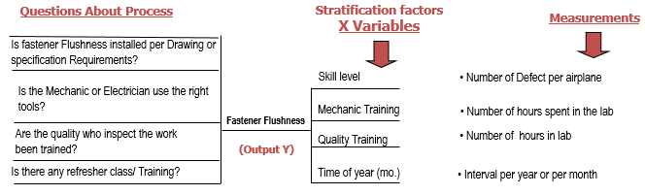
Data Stratification Tree
DMAIC
Data Stratification Tree

Slide 9
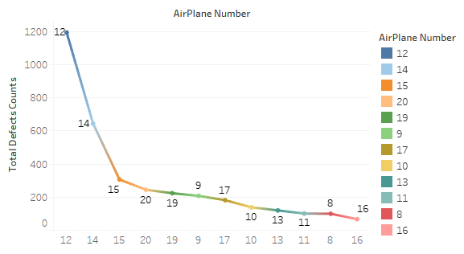
DMAIC
Trend Line Analysis
Trend Line analysis: defects per line number.
According to the chart below, line 12, almost 12,000 defects, almost double line number 14.

Slide 10
DMAIC
Root Cause Analysis: Fasteners Flushness
We deep dive to find out the source of the defects
Fastener flushness not per Dwg/spec
Insufficient training new hire (SPC &OJT)
People may not know or read the specs
SPC is area specific not Job specific
Reduced time spent in training
We need people on the floor to build airplanes
Fastener flushness not per Dwg/spec
Hole may be angled
Drill guide may not have been used
Measurements not done till end
Takes longer to use/Slows mech. down
Fastener flushness not per Dwg/spec
Countersinks are not to full depth
Mechanic borrows countersink
old csk. cutter/ wrong RPM motor
Mechanic uses Tribal knowledge
Mechanic over confident
Mechanic experience /No feedback on fast flushness
Flex track limited depth for Csk. inconsistent pressure
Mfg. not checking Csk. Depth12
Mfg. not checking holes
Mfg. does not have needed tools

Slide 11
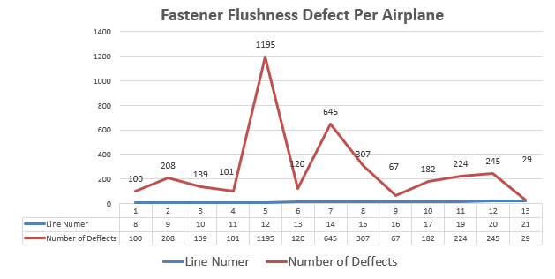
DMAIC
Run/Line chart Analytis
During root cause corrective action analysis, the group determine that there was a new hire; they are the most significant contributing factor which caused the spike on defects.

Slide 12
KAPPA Analysis: For Quality
DMAIC
Due to the outlier of my data I decided to conduct a KAPPA analysis on quality to see how stable their process.
KAPPA Criteria
Criteria
1.Use calibrated tools depth gauge
2. zero out the tool on the skin surface next to the fasteners head
3. One experienced QA and one less experience QA.
4. Advice the QA to performed the inspection like no one is watching.
5. Take QA one at a time " means don't let the other QA see how he/she measure the Fastener
flushness.
Sample size >100 Fasteners
Intent
1. To verify the tool accuracy
2. QA skills on how they set up the tool
3. 100 inspection no sampling
KAPPA Result
Two operators; QA1, 20 years of experience, QA2 7 years of experience. During the observation, both two operators are consistent on their approach from testing the tools to measuring the fastener flushness. I also used two different sheets to record the results to ensure the accuracy.
The job that I observe contains 112 total fasteners
The reproducibility, repeatability process
with confidence level of .100%
The process is very good
Operators | Good | Bad | TOTAL | Pobserved
QA1 | 104 | 8 | 112 | 1.00
QA2 | 104 | 8 | 112
QA3 GOOD | 0.93 | 0.07 |  | 1-Pchance
QA4 GOOD | 0.93 | 0.07 |  | 0.13
Pchance | 0.86 | 0.01
Total Pchance | 0.87
K | 1.00

Slide 13
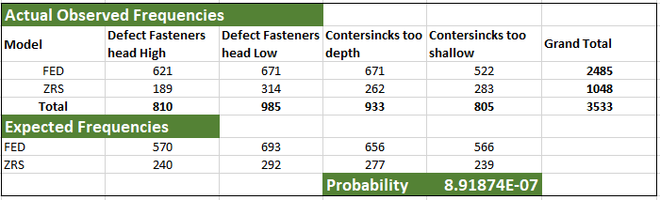
DMAIC
Chi-Test Analysis on One-Tail Test
Back ground of the data: Date time line One year consist of 12 airplanes
Hypothesis
Alpha of 0.05
Ho: The Defects and Airplane Model are independent
Ha: The Defects and Airplane Model are not dependent
Hypothesis testing
Answer: Reject the NULL hypothesis it is a lot less than 0.05. It appears to be a relationship.
With P value of 8.919E-07. The df = 3 the table only goes to 12.838

Slide 14
DMAIC
Improve: Back to Basic Training
Below is the task and personnel who are assigned to run the project.
This project is back to basic.
Task | Focal | Location | Status | ECD
Analyst | Beverlyn T. | Pat C. | Fwd. Bod. | 4/5/2019
Pull all Fwd. Bodies Csk related defects | Pat C. | Fwd. Bod. | Comp | 4//15/19
Mfg Mgrs to discuss Std. Practices | Robert. T. | Fwd. Bod. | Comp | 4/26/19
Verify Csk. Gauges availability | Robert T. | Fwd. Bod. | Comp | 4/22/2019
Schedule Work Place Center training | John H. | Fwd. Bod. | Comp. | 4/26/2019
Team Lead conduct Std Practice assessments | Mark S. | Fwd. Bod. | Comp. | 4/25/2019
Engage Mfg for RCCA determination | Natialene S. | Fwd. Bod. | Comp | 4/5/2019
Set Csk Kiosk Specification Process Center (SPC) | Will S. | Fwd. Bod. | Comp | 4/10/2019
Skin panel sample | Pat C. /Lance E. | Fwd. Bod. | comp | 5/10/2019
Analysts to pull the data for 1st ‘Gel Well Airplane #26’ | Bevelyn T. | Fwd. Bod. | comp | 5/31/2019

Slide 15
DMAIC
Improve: New Process Flow
After the intensive study and collaborations, the group found out that the
defect was cause by the process, luck of training and short cut to the process.
The group develop the new process and we develop a kiosk to test the countersink tool before using the tool on the airplane
Process Flow

Slide 16

DMAIC
Improve: New Process Result
After the training and new process implementation. First get well airplane # 26 roughly 64% percent reduction with total defect of 104.
So close to our goal of 70% reduction with 88 defect per airplane.

Slide 17
DMAIC
SQL Control: Fasteners Flushness
DPMO results between Manufacturing and Quality.
Fasteners installations process for five airplanes on five jobs. Each job contains 500 fasteners. The Sampling Process, Quality perform 20% samples out of 500.fasteners in each job. Each item has possible to have a total of 4. defects. With an actual defect of 120.
Four Defects
Fasteners head High, Fasteners head Low, Oversize Hole Undersize Hole
Defect (D) | Last 5 airplane's and 5 jobs (U) | Total defects per Airplane D*U | Total actual last 5 airplanes and 5 jobs. | DPMO on Actual 5 airplane and 5 jobs. | Million .024* 1,000,000 | SQL Table
4 | 2500 | 10,000 | 120 | 0.012 | 1,000,000 | 3.8
 |  |  |  |  | 12,000 | 98.6% confidence
The Quality Fasteners inspection process base on DPMO analysis very stable with confidence level of 98.6% .

Slide 18
We don’t have enough time to confirmed out hypothesis testing
After implementation of our new process and providing a good training to our new hire we believed this process will be better. The result of our first get well airplane showing an improvement.
Our next step
Monitor the process quarterly for sustain the gain for 5 years
Conduct the Chi test after 12 airplanes of implementation.

